Slide 1
Water saver
Save the water
SCRATCH PROJECT

Slide 2

The main game
Save the water for points, versus the evil flooder bucket.
Characters: flooder bucket, versus saver bucket

Slide 3

The problem
The road is going to flood you need to save it, and if your flooder bucket flood the road.

Slide 4

The solution
Use your bucket to save water against flooder bucket, but you can also be flooder bucket.
While your flooder bucket flood the road.

Slide 5
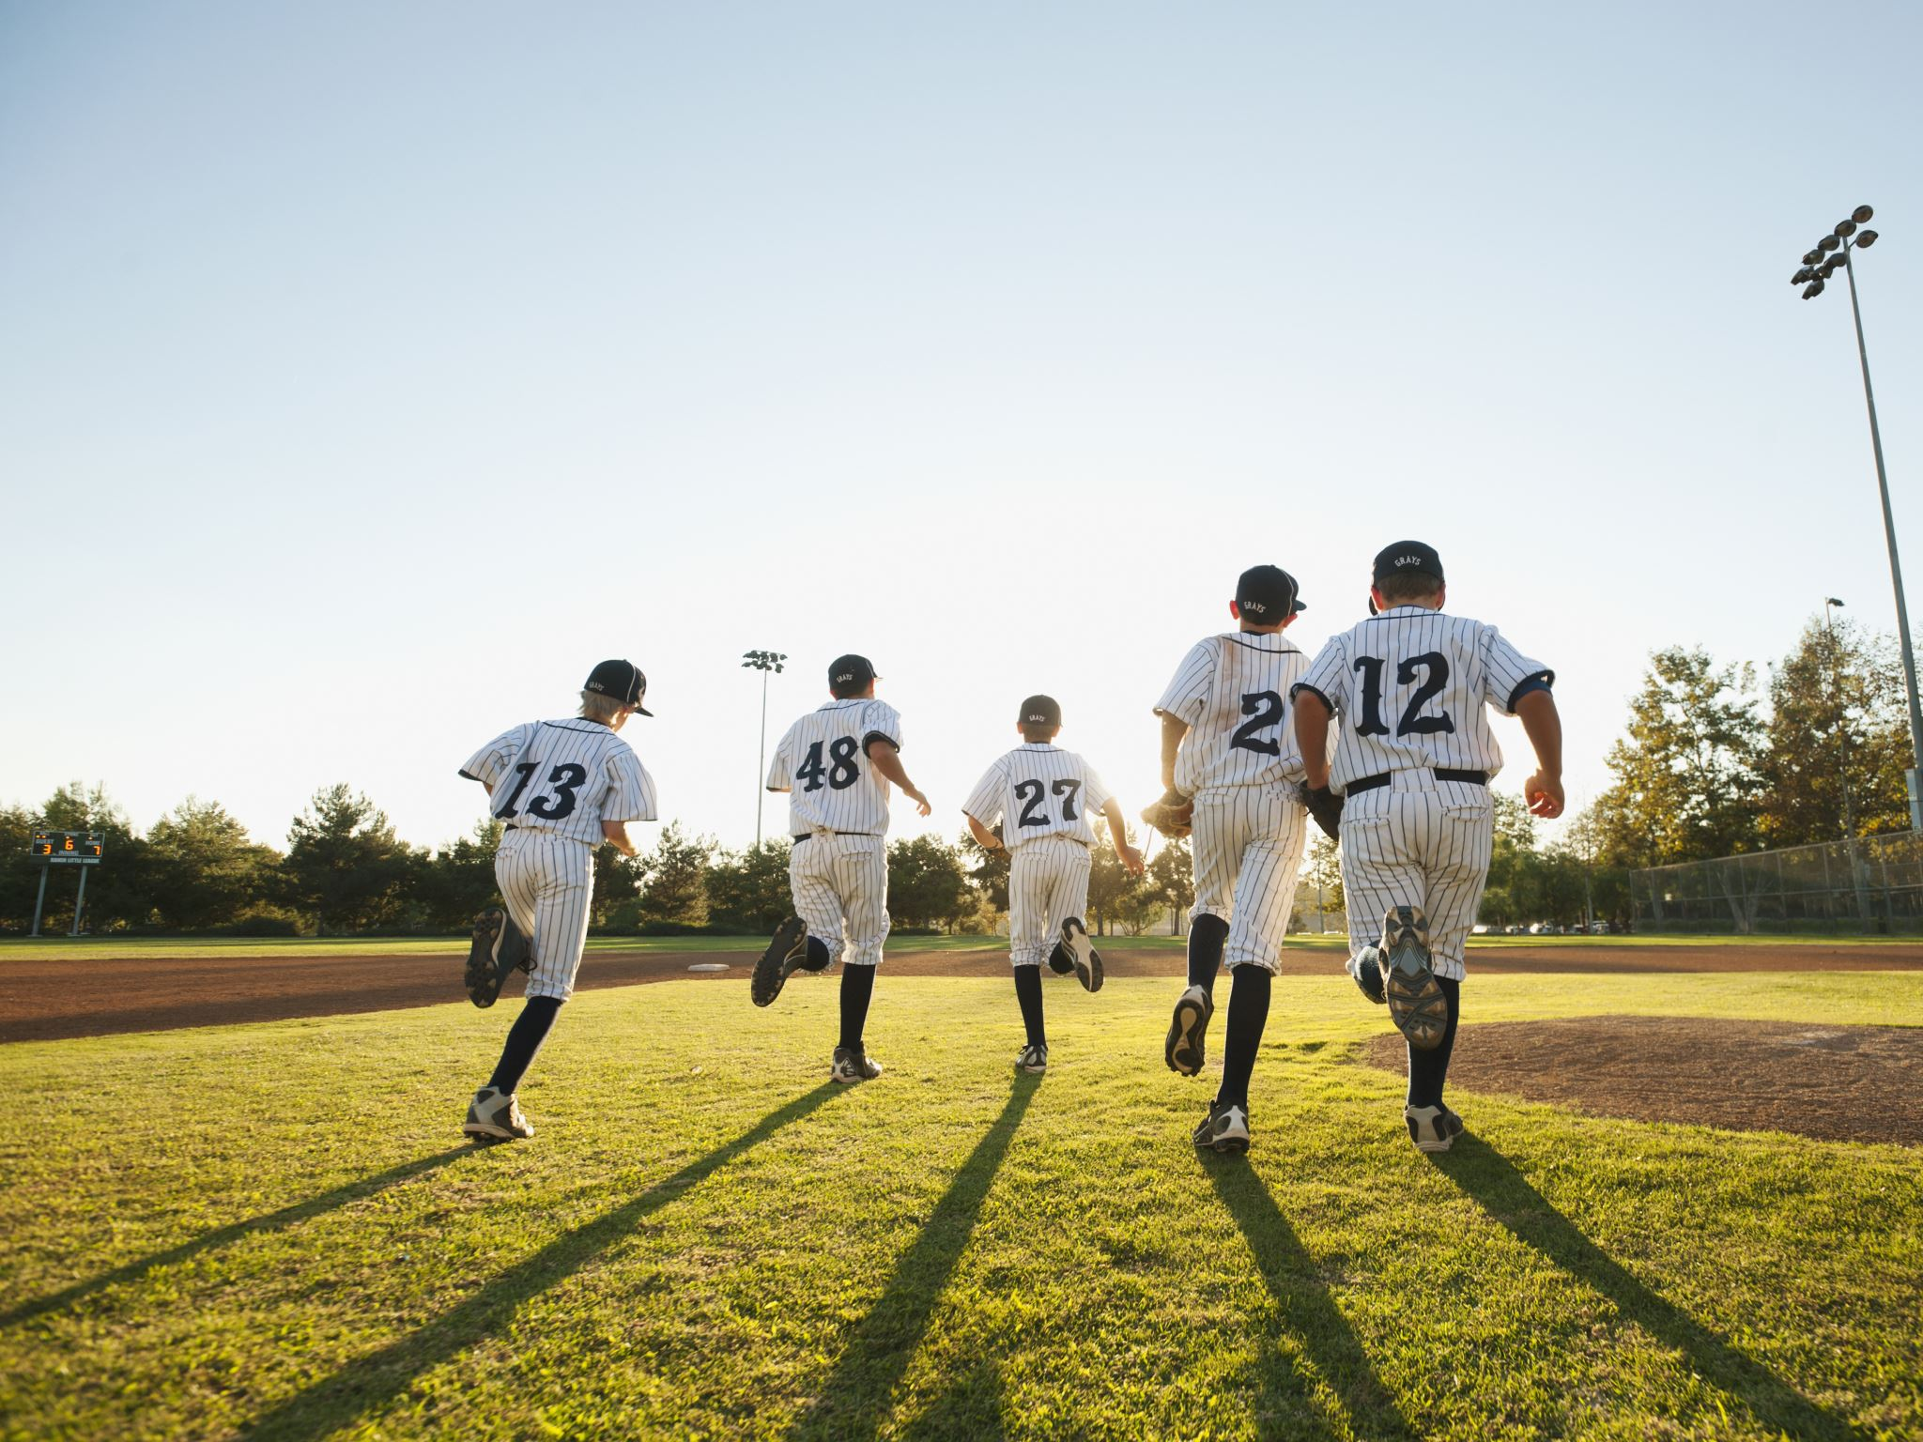
Our team
Leader: ANAS AHMAD
POWER POINTERS: YASSIN KAREEM, AND ABELRAHMAN GAMAL
SCRATCHER: OMAR ISLAM, AND HAMZA HESHAM ANAS AHMED
Notes:
OUR GOAL IS TO BE THE BEST IN THE WEST AND THE BEST TEAM IN THE WORLD FROM LEADER

